Slide 1
HEAT ENGINES
What is an engine?

Slide 2
WHAT IS HEAT ENGINE
Heat engines are mechanical devices that convert heat (thermal) energy to mechanical energy.
Heat is generated by the combustion of fossil fuel
The invention of heat engines and their subsequent widespread adoption, was a crucial element of the Industrial.
For the third world they are likely to have an equally important role in development.
Therefore, heat engines are of great importance

Slide 3
TYPES OF HEAT ENGINES
Heat engines can be divided into two main classes subject to how heat is supplied to the engine.
Internal combustion engines
External combustion engines

Slide 4
INTERNAL COMBUSTION ENGINES
Internal combustion engines (ICE) are engines where the heat generated by the combustion of fuel takes place within the engine.
The chamber where the combustion takes place is known as combustion chamber
Example of such internal combustion engines are:
Spark ignition, and
Compression ignition engine
The internal combustion engine are also known as reciprocating engines.
Gas turbine

Slide 5
SPARK IGNITION ENGINE
Spark ignition engine (SIE)
This type of engine initiates burning by using an electric spark to ignite the air-fuel mixture inside the combustion chamber - such as petrol and gas engines.

Slide 6
COMPRESSION IGNITION ENGINE
Compression ignition engine (CIE) –
It simply initiates burning by compression to increase the temperature and pressure of the air inside the engine before introducing fuel into the combustion chamber of the engine.
such as diesel engines.
This type of engine does not require a spark to initiate combustion

Slide 7
EXTERNAL COMBUSTION ENGINE
External combustion engines are engine where the heat generated from the combustion of fuel does not take place inside but external
The heat required is transferred to the engine from an external source.
Examples are
steam engines and
stirling engine

Slide 8
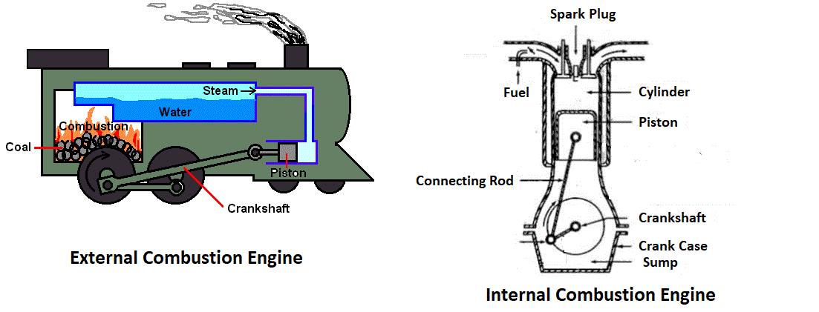

Slide 9
GAS TURBINE
Gas turbine is a type of internal combustion (IC) engine in which burning of an air-fuel mixture produces hot gases that spin a turbine to produce power.
It is the production of hot gas during fuel combustion, not the fuel itself that gives gas turbines the name.
Gas turbines can utilize a variety of fuels, including natural gas, fuel oils, and synthetic fuels.
Combustion occurs continuously in gas turbines, as opposed to reciprocating IC engines, in which combustion occurs intermittently.

Slide 10
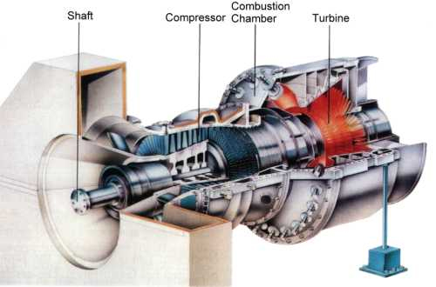

Slide 11
Marine Diesel Engine
Diesel engine is a type of internal combustion engine, and works with the principles of compression ignition.
The fuel used can be marine diesel oil (MDO), or Heavy fuel oil (HFO) depending on the type of engine.
In common with all internal combustion engines the diesel engine has a fixed sequence of events with which it operates.

Slide 12
Basic engine components
An engine is made up of the following basic components:
The block (engine block)
Cylinder liner
Piston
Cylinder head
Crankshaft
Piston rods/crosshead
Connecting rod

Slide 13
Engine Components
Connecting rod
Camshaft
Turbocharger
Bedplate and Frame. etc

Slide 14
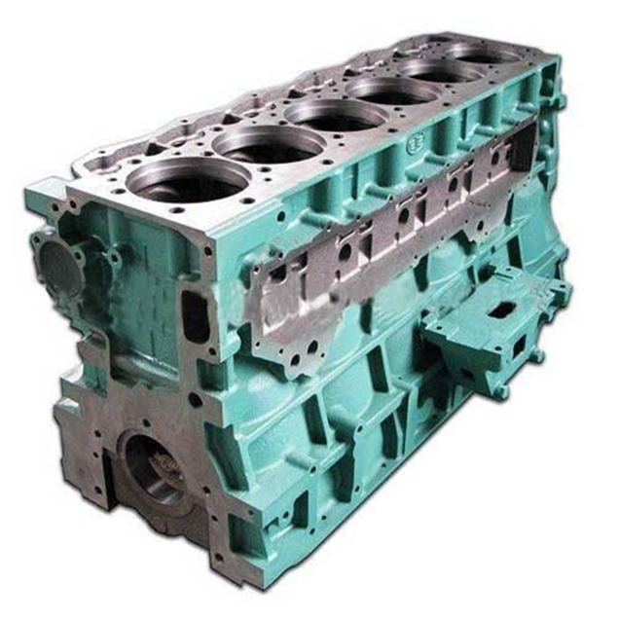
Engine Components
Engine Block:
This is the main structure of the engine and is manufactured as a single piece. It supports the main components of the engine such as the crankcase, cylinder head, crankshaft, camshaft and other associated surrounding components. Inside the engine block we have cylinder itself and inside the cylinder is the piston.

Slide 15
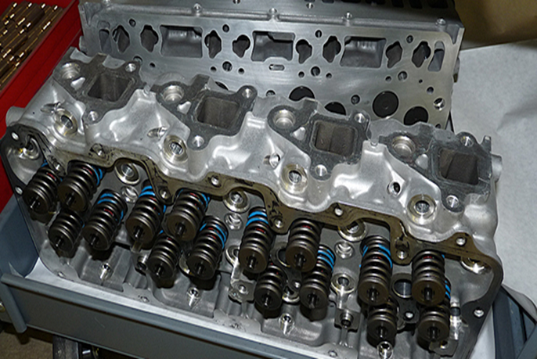
Engine Components
Cylinder head:
Cylinder head in internal combustion engines, sits above the cylinders on top of the cylinder block. It closes the top of the cylinder and acts as a seal, it also forms part of the combustion chamber. It also forms a means of attachment of other components.

Slide 16
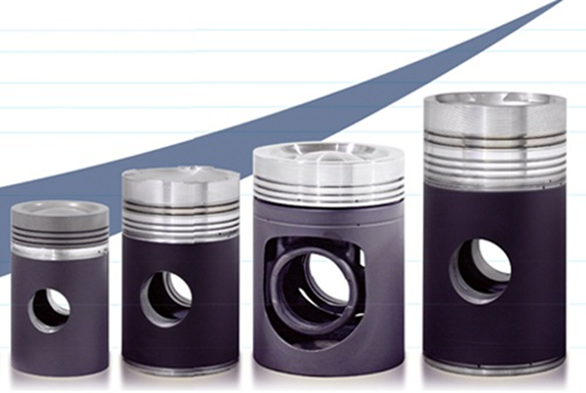
Engine Component
Piston:
Piston forms the lower part of the combustion chamber of a marine engine which transforms the gas pressure in the combustion chamber to the connecting rod. The piston is responsible for compression of the air/ air-fuel mixture in the cylinder.

Slide 17
Engine Components
Piston rods:
Found only in crosshead engines. They are bolted to the piston and tom the crosshead.

Slide 18
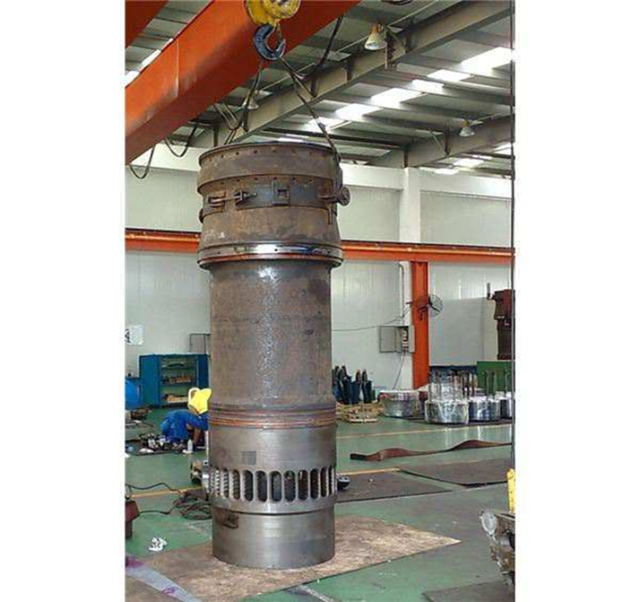
Engine Components
Cylinder liner(2-stroke engine )
The cylinder liner or sleeve acts as a sliding surface for the piston rings
guides the piston reciprocating movement
It receives combustion heat through the piston and piston rings and transmits the heat to the coolant and it prevents the compressed gas and combustion gas from escaping.

Slide 19
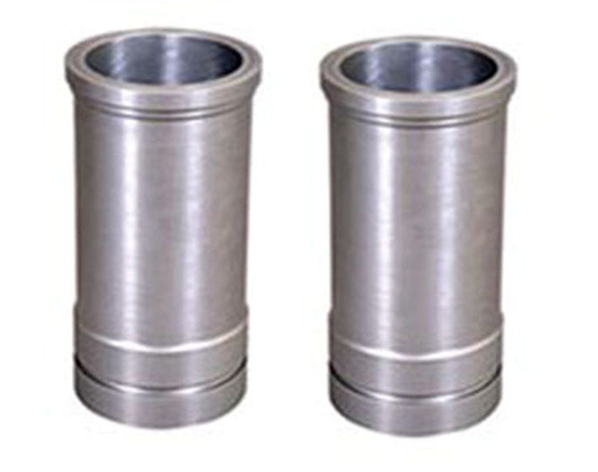

Engine Components

Slide 20
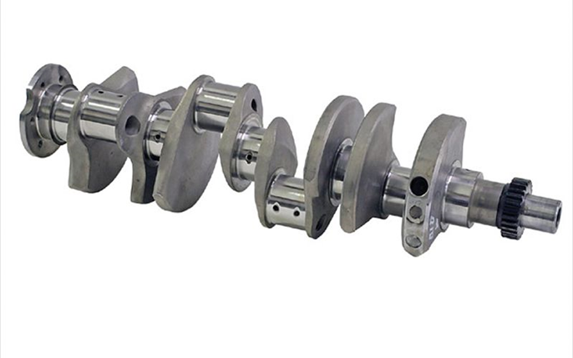
Engine Components
Crankshaft:
The crankshaft receives oscillating motion from the connecting rod and converts it to rotary motion to the.
They are either fogged in one piece or semi-built (in large, low-speed engines)
It drives the camshaft which actuates the valves of the engine.
It acts as the prime mover that transmits power to other components and power to drive the huge propeller.

Slide 21
Engine Components
Connecting rods:
The have bearing at the bottom for crankpin. In trunk-piston engines the connecting rod may be fixed to a pin, which is free to swing in the piston bosses

Slide 22
Engine Components
Camshaft:
They are fixed with cams which controls different items such as fuel injection pumps, air valve, and exhaust valve

Slide 23
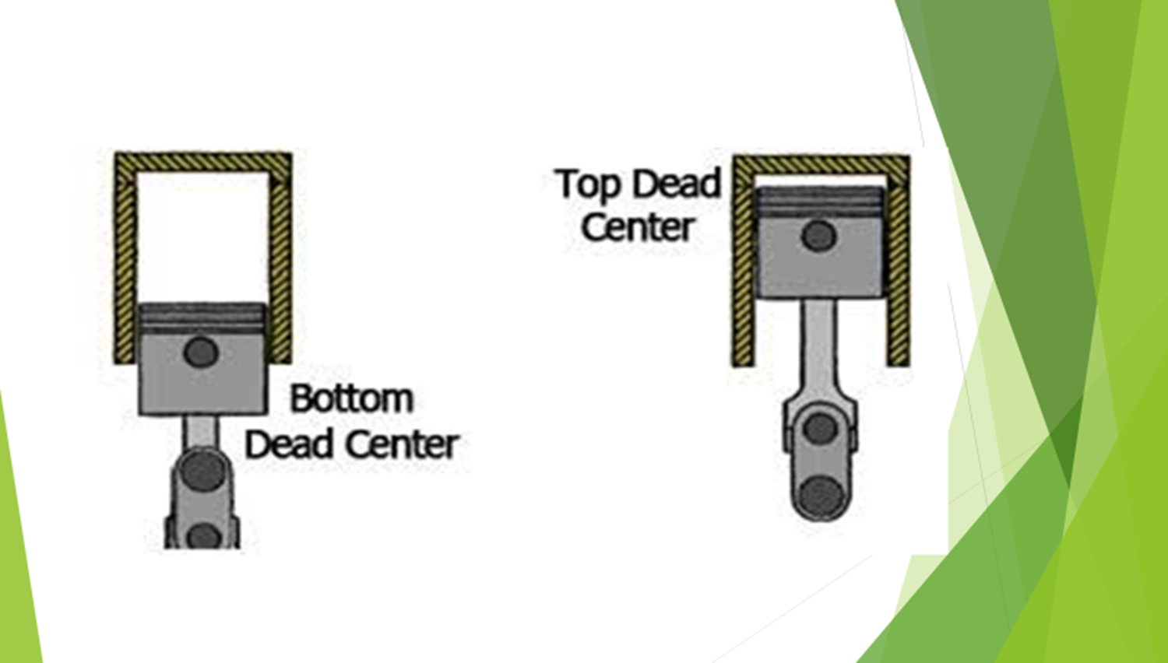
Definitions
Top dead Centre (TDC) – this is the furthest point at the top a cylinder a piston can travel when on its upward stroke
Bottom dead Centre (BDC) – this is the furthest point at the bottom of the cylinder where the piston is nearest to the crankshaft

Slide 24
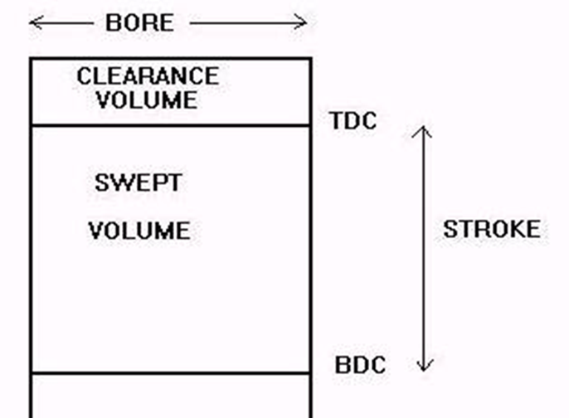
Definitions
Piston Stroke
The distance traveled by the piston from zero degrees to 180 degrees or the distance traveled from TDC to BDC/BDC to TDC

Slide 25
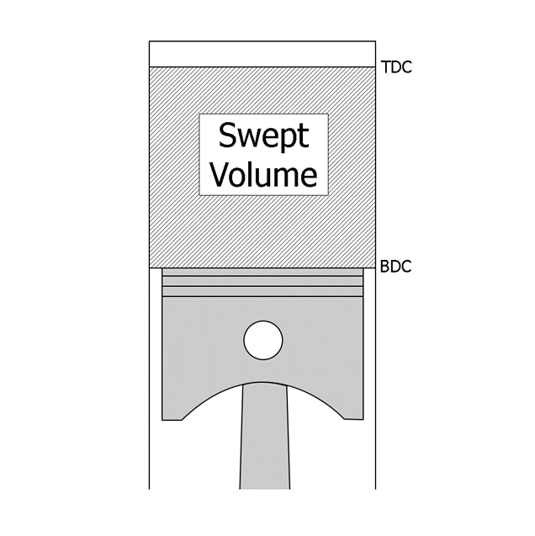
Definitions
Swept Volume
this is the volume between TDC and BDC as the piston makes a stroke

Slide 26

Definitions
Clearance Volume
this is the volume or distance between the piston top and the underside of the cylinder head when the piston is at TDC

Slide 27
Types of Diesel Engines
There are different types based on the working principle.
There are two basic principles of operation of diesel engines. These are the:
two-stroke and
four-stroke diesel engines

Slide 28
Types of Diesel Engine
Four-stroke diesel engine
The engine takes four strokes of the piston or four reciprocating movement of the piston and two revolutions of the crankshaft at 720 degrees to complete one working cycle of operation.
This principle is applied in high-speed and medium-speed diesel engines, and are trunk piston engines

Slide 29
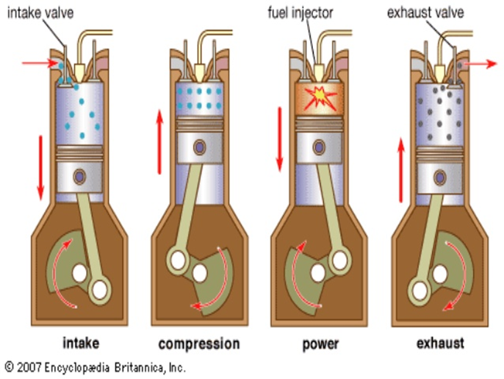
Types of Diesel Engine
Four-stroke diesel engine
Induction stroke
Compression stroke
Power/Expansion stroke
Exhaust stroke

Slide 30
Types of Diesel Engine
Two-stroke diesel engine
The principle is most often applied in small and very large sized diesel engines. The very large sized diesel engines are crosshead engines.
The two-stroke cycle is completed in two strokes of the piston and one revolution of the crankshaft at 360 degrees

Slide 31
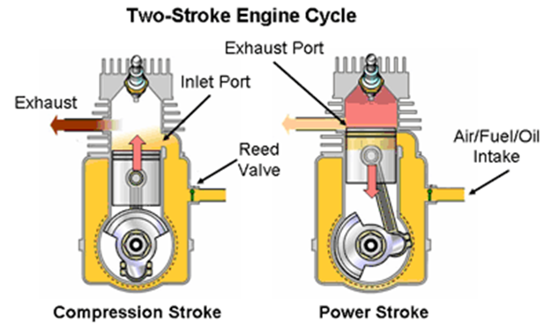
Types of Diesel Engine
Two-stroke engine
The two-stroke diesel engine operates two up/down movement of the engine
Compression stroke, and
Power stroke

Slide 32
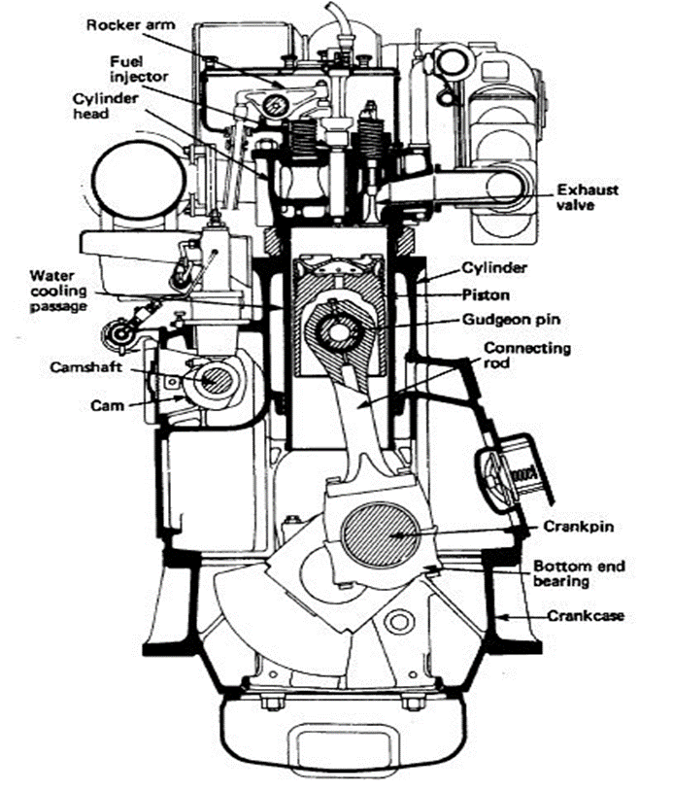
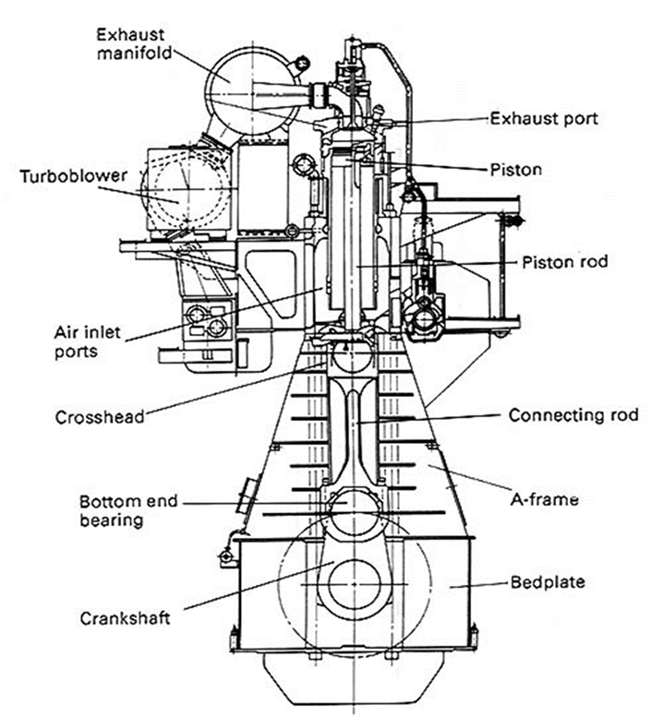
Differences between 2-stroke and 4-stroke

Slide 33
Differences b/w 2 stroke and 4 stroke engines
S/NO | TWO-STROKE DIESEL ENGINE | FOUR-STROKE DIESEL ENGINE
1 | Two reciprocating movement of the piston in one cycle | Four reciprocating movement of the piston in one cycle
2 | One revolution of the crankshaft in one complete cycle of operation | Two revolutions of the crankshaft in one complete cycle of operation
3 | Two stroke engines have inlet ports | Four stroke engines have inlet and exhaust valves
4 | They are slow speed engines | They are medium and high speed engines
5 | They have uniflow scavenge system | Does not have
6 | They have cross scavenge system | Does not have
7 | They have loop scavenge method | Does not have
8 | They can turn in both directions | They are unidirectional engines
9 | They are crosshead engines | They are trunk piston engines
10 | Some are of the opposed piston type
11 | Two stroke slow speed engines do not require a reduction gear | Four stroke high speed engines require a reduction gear

Slide 34
Bilge and Ballast system
The bilge system and the ballast system each have specific functions to perform, but are interconnected in many ways. They are both part of a ships pumping system.
Bilge System:
A bilge is the lowest space of the ship. Ships are provided with watertight compartments meant for collecting water due to leakage, condensation, washing, fire fighting etc.in the engine room/machinery space. These bilge compartments are also known as bilge wells, where all the bilge water gets accumulated
The bilge main is arranged to drain these watertight compartments of water and to discharge the contents overboard
It is to be capable of controlling flooding in the Engine Room as a result of limited damage to piping systems.

Slide 35
Bilge System
Bilge water is not precisely water but a mixture of different substances as the case may be. Its a mixture of fresh water, sea water, oil, sludge, chemicals and various other liquids.
Fresh water and seawater can find its way to the bilge wells due to leakage in the pipe lines, leaky pump and valve glands, from machinery, propulsion system, over flowing of tanks and even due to accidental spills.
All these substances get accumulated in the bilge wells and the mixture formed is known as bilge or bilge water.

Slide 36
Bilge System
The number of pumps in the system and their capacity depend upon the size, type and service of the vessel.
The bilge suctions are fitted with suitable strainers, which in the machinery space would be mud boxes placed at floorplate level for easy access. A vertical drop pipe would lead down to the bilge.
Emergency bilge suction or bilge injection valve is provided in the system, used to prevent flooding of the ship. It is a direct suction from the machinery space bilge which is connected to the largest capacity pump or pumps.
A centrifugal pump with a priming device is usually used, driven by an electric motor housed in an air bel

Slide 37
Ballast system
A ships ballast system is basically used for correcting the trim of the ship. It has tanks (ballast tanks), pumps, and pipe network.
The ballast system is arranged to ensure that water can be drawn from any tank or from the sea and discharged to any other tank or to the sea as necessary to trim the vessel.
The system is arranged in such a way that only the appropriate pipeline is in service, while the other must be securely blanked or closed off.

Slide 38
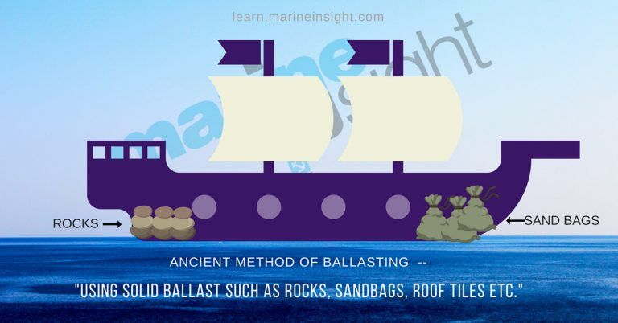

Slide 39
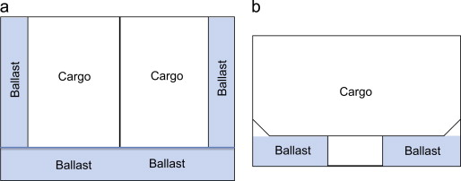

Slide 40
Importance of Ballast System
Ballasting of ship helps to reduce stresses on ship’s hull and also provides transverse stability of the ship
As the propeller is submerged, it aids the propulsion plant in maintaining its efficiency
Ballast helps in immersing the rudder, supporting the manoeuvrability of vessel and also reducing the exposed hull surface
The ship continually uses fuel and water from its tanks leading to weight loss. The ballast operation helps in compensating for the weight loss

Slide 41
Types Of Ballast Conditions
Light Ballast: When the ship is heavily loaded, and it does not require an additional ballast, the water ballast tanks are kept empty. This condition is known as a light ballast.
Heavy Ballast: During the seagoing state, if the ship is not fully loaded, ship ballast tanks are filled to its capacity. This condition is known as a heavy ballast.
Port Ballast: Many ports around the world have a restriction for usage of ballast water. Dedicated port ballast tanks are provided to correct the trim and list of the ship during loading or discharging operation, and this is called port ballast.

Slide 42
Types of Ballast Tanks
There are two types of ballast tanks, namely;
Clean Ballast Tanks (CBT)
Segregated Ballast Tanks (SBT)

Slide 43
Types of Ballast tanks
Segregated Ballast Tanks
The segregated ballast tanks (SBT) are dedicated tanks constructed for the sole purpose of carrying ballast water on oil tanker ships. They are completely separated from the cargo, and fuel tanks and only ballast pumps are used in the SBT.
The Segregated ballast tanks avoid any chances of mixing oil and water which usually happens when cargo holds are used to carry ballast water.

Slide 44
Types of Ballast Tanks
Clean Ballast Tanks (CBT)
Oil tankers may travel without carrying cargo in its holds which might lead to stability issues, especially in bad weather. therefore, the cargo holds which were used to carry oil in the last voyage are then cleaned and used to fill in clean water for ballasting purpose.

Slide 45
Steering gear
The steering gear provides a port or starboard side movement of the rudder in response to a signal from the bridge.
The steering gear system is comprised of three parts:
Control unit – telemotor (hydraulic transmitter)
Power unit
Transmission

Slide 46
Steering gear - Power unit
There are two common types of hydraulically powered transmission units or steering gear, namely:
ram type, and
rotary vane type.
The ram type can either be two-rams or four-rams

Slide 47
Ram type steering gear

Slide 48
Marine Steam Power Plant
Steam power plant onboard ships is used to generate power that drives the steam turbine which propels the ship, drives auxiliary machines, and for other shipboard services.
A boiler is used onboard ships to generate steam by heating water.
The steam produced is under high pressure and temperature.
The boiler has a furnace or combustion chamber where fuel is burnt to release its energy. The energy released is transferred to the water to generate steam.

Slide 49
Marine Steam Power Plant
Uses of steam onboard
To drive Steam turbine
To drive auxiliary machines – cargo pumps, deck equipment etc
For heating

Slide 50
Components of steam power plant
The main components of a steam power plant are;
Boiler
Steam turbine
Condenser
Feed water pump

Slide 51
Marine Power Plant – Steam generation
The steam generation process is a cycle
BOILER
TUEBINE
FEED WATER PUMP
CONDENSER

Slide 52
Components of steam power plant - functions
Boiler – the boiler generates high pressure steam from the water. It is contains a furnace where combustion of fuel takes place
Steam turbine – this is a mechanical device that converts the kinetic energy of the steam into mechanical energy which drives the propeller via the rotor
Condenser – it condenses the used steam that leaves the turbine. It converts the low pressure steam to water.
Feed water pump – this is used to transfer the feed water to the boiler

Slide 53
Marine Power Plant – types of Boiler
There are two types of boiler in existence fire-tube and water-tube boilers
Water-tube boiler - The water tube boiler is designed in such a way that, the water (feed water) is circulated or passes through tubes and the heat required for heating is passed around the tubes
Fire-tube boiler - This is designed in such a way that the heat generated for heating the feed water is passed through tubes while the feed water circulates around the tubes.

Slide 54
Marine Power Plant – boiler mountings and Attachment
Main steam stop valve (non-return type of valve)
Safety valves (for overpressure)
water level gauge glass
Air release valve (during depressurizing) cock
Feed check and control valve
Pressure gauge (checked periodically)
Blowdown valve (used to empty boiler or to reduce water level)

Slide 55
Marine Power Plant – boiler mountings and Attachment
Scum blowdown valve (allow blow down of floating impurities-oil foaming)
Soot blowers (expel soot and combustion products from tube surfaces)
Low water level alarm
Feed water regulator (Automatic)
Auxiliary steam stop valve (back up to main steam stop valve)
whistle stop valve

